Slide 1


Numeric and conversion
Validation Test Team
Dao Xuan Truong
01/2021

Slide 2

Agenda
01
Numeral Systems
02
Number Base Conversion
03
Bit and Byte

Slide 3
I. Numeral Systems – Define
Sets of symbols and the rules for using them to represent numbers, which are used to express how many objects are in a given set
A writing method for expressing numbers is called a "numeral system". In the most common numeral system, we write numbers with combinations of 10 symbols {0,1,2,3,4,5,6,7,8,9}. These symbols are called digits, and numbers that are expressed using 10 digits are called "decimal" or "base-10" numbers.
Numeral Systems
Binary | Base 2
Ternary | Base 3
Quaternary | Base 4
Quinary | Base 5
Senary | Base 6
Septenary | Base 7
Octal | Base 8
Nonary | Base 9
Decimal | Base 10
Undenary | Base 11
Doudenary | Base 12
Hexadecimal | Base 16
Sexagesimal | Base 60
01 / 13

Slide 4
I. Numeral Systems - Common numeral Systems
The other most common numeral systems are binary, decimal, hexadecimal
The binary numeral system, or base-2 number system, represents numeric values using two symbols: 0 and 1. More specifically, the usual base-2 system is a positional notation with a radix of 2. Because of its straightforward implementation in digital electronic circuitry using logic gates, the binary system is used internally by almost all modern computers.
Numeral Systems
Binary
(Base 2)
Decimal
(Base 10)
Hexadecimal
(Base 16)
Uses digits
0 & 1
Uses digits
0-9
Uses digits 0-9
Alphabets: A-F (equal 10-15 in decimal)
10011011
5940264
5F8BC6E
A5FC89: Binary, Decimal, Hexadecimal ?
845100: Binary, Decimal, Hexadecimal ?
1001011: Binary, Decimal, Hexadecimal ?
02 / 13

Slide 5

II. Number Base Conversion
Decimal
Binary
Hexadecimal
03 / 13

Slide 6
II. Number Base Conversion - Decimal to Binary and Hexadecimal
How to convert
Divide the number by 2/16.
Get the integer quotient for the next iteration.
Get the remainder for the binary/Hexadecimal digit.
Repeat the steps until the quotient is equal to 0, getting remainders from bottom to top
Example
Decimal to Binary
Decimal to Hexadecimal
(10)₁₀ = (?)₂
(41719)₁₀ = (?)₁₆
10
2
41719
16
0
5
2
7
2607
16
1
2
2
162
16
0
1
2
15
10
16
1
0
2
0
10
(10)₁₀ = (1010)₂
(41719)₁₀ = (A2F7)₁₆
04 / 13

Slide 7
II. Number Base Conversion - Binary to Decimal
How to convert
Write down the powers of 2.
Under each power of two result, write the corresponding bit value
Multiply each bit value with the corresponding power of 2 and add the products together
The result of the sum is the decimal number
Example
(1010)₂ = (?)₁₀
STEP 1
2³ 2² 2¹ 2⁰
STEP 2
1 | 0 | 1 | 0
0.2⁰
1.2¹
STEP 3
0.2²
1.2³
STEP 4
(1010)₂ = (1.2³ + 0.2² + 1.2¹ + 0.2⁰)₁₀
= (10)₁₀
05 / 13

Slide 8
II. Number Base Conversion - Hexadecimal to Decimal
How to convert
Write down the powers of 16.
Under each power of 16 result, write the corresponding bit value
Multiply each value with the corresponding power of 16 and add the products together
The result of the sum is the decimal number
Example
(A2F7)₁₆ = (?)₁₀
STEP 1
16³ 16² 16¹ 16⁰
STEP 2
A | 2 | F | 7
7.16⁰
F.16¹
STEP 3
2.16²
A.16³
(A2F7)₁₆ = (A.16³ + 2.16² + F.16¹ + 7.16⁰)₁₀
= (10.16³ + 2.16² + 15.16¹ + 7.16⁰)₁₀
= (41719)₁₀
STEP 4
06 / 13

Slide 9
II. Number Base Conversion - Binary to Hexadecimal
How to convert
Write down the binary number and group the digits (0’s and 1’s) in sets of four. Start doing this from the right. If the leftmost group doesn’t have enough digits to make up a set of four, add extra 0’s to make a group.
Write 8, 4, 2 and 1 below each group. These are the weights of the positions or place holders in the number (23, 22, 21 and 20).
Every group of four in binary will give you one digit in hexadecimal. Multiply the 8, 4, 2 and 1’s by the digit above.
Add the products within each set of four. Write the sums below the groups they belong to.
The digits you get from the sums in each group will give you the hexadecimal number, from left to right.
Example
(10101101)₂ = (?)₁₆
 | 1010 | 1101
 | 8 4 2 1 | 8 4 2 1
 | 8 0 2 0 | 8 4 0 1
 | 10 (10 = 8+2) | 13 (13 = 8+4+1)
 | A | D
 | (10101101)₂ = (AD)₁₆
STEP 1
STEP 2
STEP 3
STEP 4
STEP 5
07 / 13

Slide 10
II. Number Base Conversion - Hexadecimal to Binary
How to convert
Write down the hex number. If there are any, change the hex values represented by letters to their decimal equivalents.
Each hex digit represents four binary digits and therefore is equal to a power of 2. The rightmost digit equals to 20 (1), the next one equals to 21 (2), the next one equals to 22 (4) and the leftmost one equals to 23 (8). Write these numbers (8, 4, 2 and 1) below the hex values.
Determine which powers of two (8, 4, 2 or 1) sum up to your hex digits. For example, if one of your hex values is 10, this means 8 and 2 sum up to 10 (4 and 1 are not used). If your hex number is 2, only 2 is used; 8, 4 and 1 are not.
Write down 1 below those 8, 4, 2 and 1’s that are used. Write down 0 below those that are not used.
Read the 1’s and 0’s from left to right to get the binary equivalent of the given hex number.
Example
(4FA)₁₆ = (?)₂
STEP 1
 | 4 | F | A
 | 4 | 15 | 10
 | 8 4 2 1 | 8 4 2 1 | 8 4 2 1
 | 8 4 2 1 | 8 4 2 1 | 8 4 2 1
 | (4 = 4) | (15 = 8+4+2+1) | (10 = 8+2)
 | 0100 | 1111 | 1010
 | (4FA)₁₆ = (10011111010)₂
STEP 2
STEP 3
STEP 4
STEP 5
8 / 13

Slide 11
II. Number Base Conversion - Practice
Case 1: (11001011)₂ = (?)₁₆
Case 2: (11100110)₂ = (?)₁₆
Binary
1 | 1 | 0 | 1 | 0 | 1 | 0 | 1
Binary
1 | 1 | 0 | 0 | 0 | 0 | 1 | 0
D | 5
Hexadecimal
C | 2
Hexadecimal
(11001011)₂ = (D5)₁₆
(11100110)₂ = (C2)₁₆
Case 3: (D5)₁₆ = (?)₂
Case 4: (C2)₁₆ = (?)₂
Binary
0 | 0 | 1 | 0 | 1 | 0 | 1 | 0
Binary
1 | 1 | 1 | 0 | 0 | 1 | 1 | 1
2 | A
Hexadecimal
E | 7
Hexadecimal
(2A)₁₆ = (00101010)₂
(E7)₁₆ = (11100111)₂
9 / 13

Slide 12
II. Number Base Conversion - Enhance
Fractional Number
Decimal | Binary | Hexadecimal
0.71875 (1.2⁻¹ + 0.2⁻² + 1.2⁻³ + 1.2⁻⁴ + 1.2⁻⁵ ) | 0.10111 | 0.B8 (0.10101000)
0.1012625 (1.16⁻¹ + A.16⁻² ) | 0.0001101 (0.00011010) | 0.1A
0.75 | 0.11 (0.75x2= 1.5 → 0.5x2= 1.0→0x2 = 0.0) | 0.C 0.75x16 = 12.0 → 0x16 = 0.0
Remember
Decimal | Binary | Hexadecimal
0 | 0000 | 0
1 | 0001 | 1
2 | 0010 | 2
3 | 0011 | 3
4 | 0100 | 4
5 | 0101 | 5
6 | 0110 | 6
7 | 0111 | 7
Decimal | Binary | Hexadecimal
8 | 1000 | 8
9 | 1001 | 9
10 | 1010 | A
11 | 1011 | B
12 | 1100 | C
13 | 1101 | D
14 | 1110 | E
15 | 1111 | F
10 / 13

Slide 13
III. Bit and Byte – Define
Define
Bit (Binary Digit)
Bit is the smallest unit of information that can be stored.
It consists of either zero or one.
Byte
The byte is a unit of digital information that most commonly consists of eight bits
Historically, the byte was the number of bits used to encode a single character of text in a computer
Example: 01000001
Byte field
Bit position | 7 | 6 | 5 | 4 | 3 | 2 | 1 | 0
Value | 0 | 1 | 1 | 0 | 1 | 0 | 0 | 1
11 / 13

Slide 14
III. Bit and Byte – Define - Logical Shift
These instructions shift an operand over a number of bit positions specified in a count operand contained in the instruction.
Left Shift
Example: Left shift 2 positions
Before
1 0 0 0 1 1 0 1 ………0 1 0 0 1 1
After
0 0 1 1 0 1 ………0 1 0 0 1 1 0 0
Right Shift
Example: Right shift 3 positions
Before
1 0 0 0 1 1 0 1 ………0 1 0 0 1 1
After
0 0 0 1 0 0 0 1 1 0 1 ………0 1 0
12 / 13

Slide 15
III. Bit and Byte – Define - Logical instructions
1. NOT
2. OR
A | NOT A
1 | 0
0 | 1
A | B | A or B
0 | 0 | 0
0 | 1 | 1
1 | 0 | 1
1 | 1 | 1
NOT(0111)
= 1000
0110
1010
= 1110
3. AND
4. XOR
A | B | A&B
0 | 0 | 0
0 | 1 | 0
1 | 0 | 0
1 | 1 | 1
A | B | A XOR B
0 | 0 | 0
0 | 1 | 1
1 | 0 | 1
1 | 1 | 0
0110
1101
= 0100
1101
1011
= 0110
13 / 13

Slide 16
Q&A

Slide 17
Thank you

Slide 18
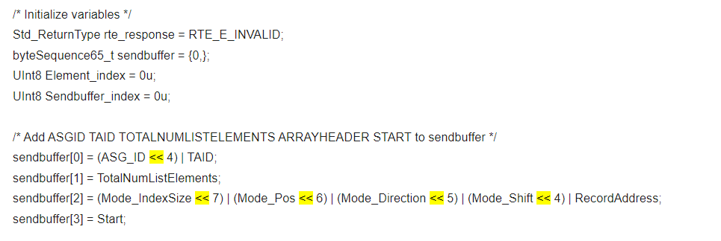
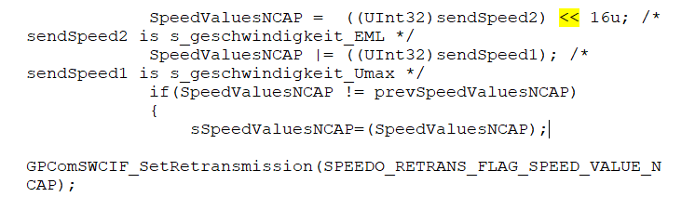
A1. Logical Shift Example
SyRS
Coding
13 / 13

